Slide 1







MarketGauge
Hudson, Moe, Kennadi, Tyler, and Eric

Slide 2



Our App
Our app is a tool to help users get a better understanding of what they could be investing in. It lets you search for stocks and gives you a rating with other analytics to help you make the most out of your money.

Slide 3
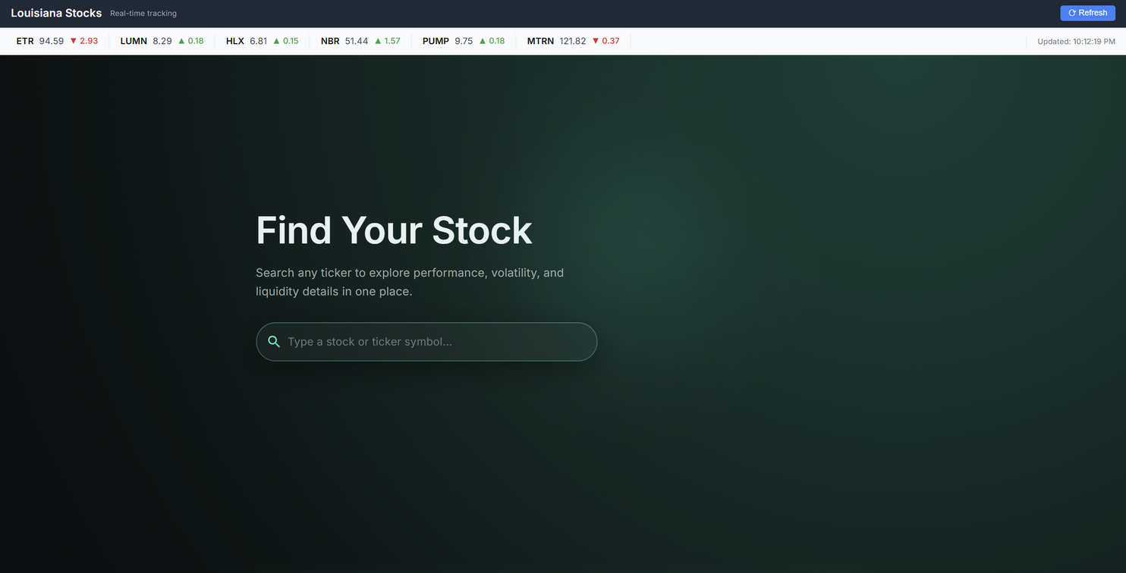

Features
Real-time data
Simple and clean UI
30-day price history
Market Forecasting
Louisiana stock highlight

Slide 4

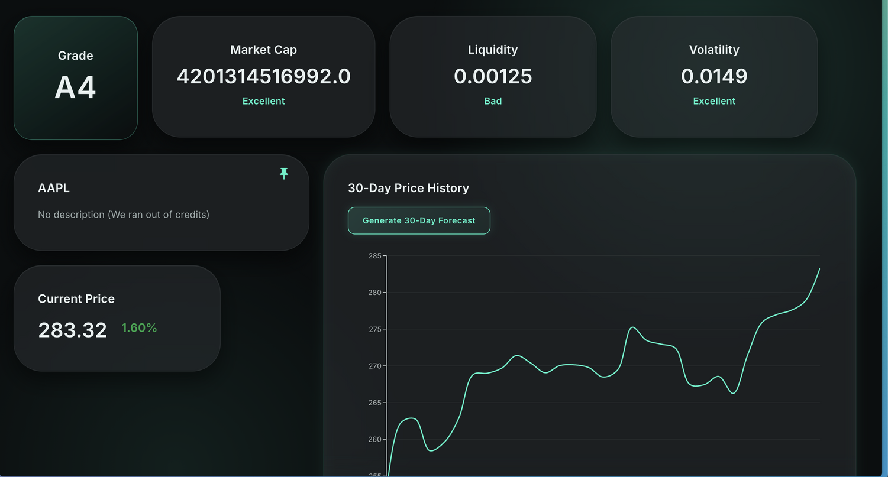

How it Works
Our algorithm analyzes and grades stocks based on volatility, market cap, and liquidity to determine if they’re worth investing in. We evaluate each stock's performance based on the past 90 days to ensure the most accurate grading possible.

Slide 5





Tools Used
React
GitHub
Python

Slide 6


Future Improvements
Add crypto
Give recommended stocks
Hype scale
More advanced dashboard
Investment predictor

Slide 7

Demo
http://localhost:5173

Slide 8
Thank You

